Slide 1

Random Password Generator
Stay safe from hackers…
Use
Lucas

Slide 2

The Game
To create a safe and random password that fullfills your customized requirements

Slide 3
Challenges
Deciding what code to use for the Boolean conditions
Making the code error-free

Slide 4

Process
Create an input function for desired number of characters
Create a boolean requirement for letters, number and symbols
Create variables to store the possibilities for chosen options
Create an empty list to collect each character
Create a conditional for loop to iterate through the desired length from the stored possibilities
Append the empty list from each collected character
Generate a randomly generated password

Slide 5
Lessons
To, from the begining, focus on readability so that you easily can run through your code and see where the problem lies in an error.

Slide 6
Highlights When it worked

Slide 7
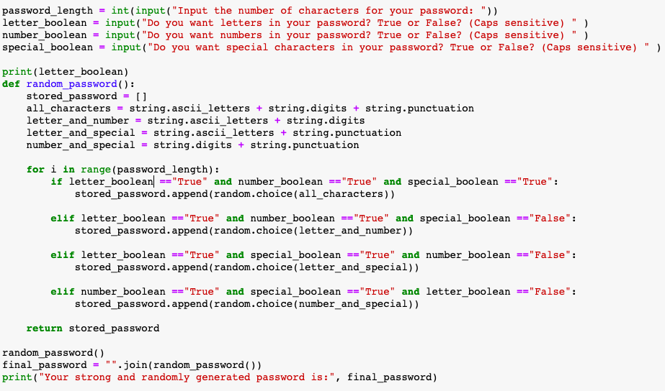

Slide 8
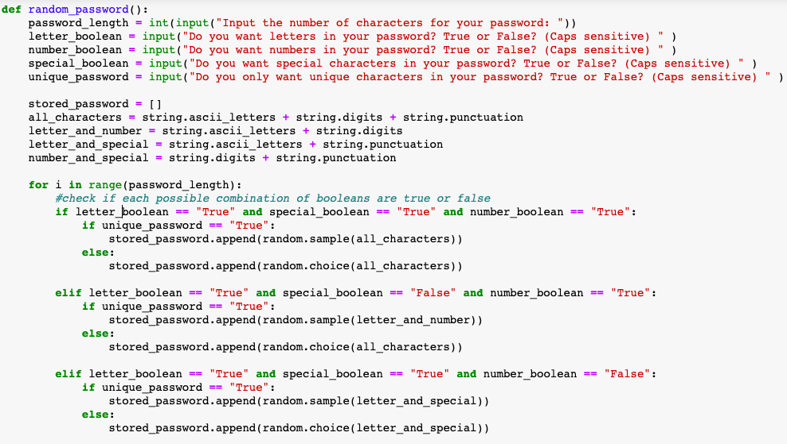

Slide 9
